Slide 1
Module 6
REST APIs

Slide 2
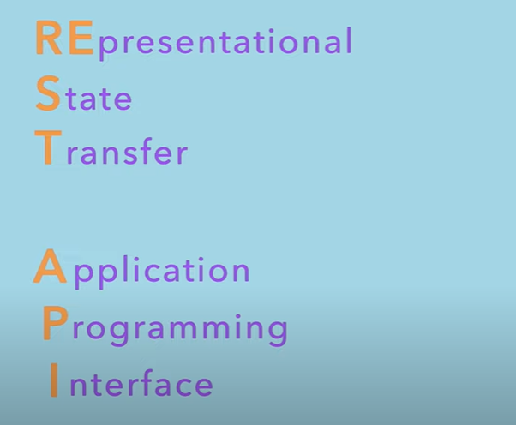

Slide 3
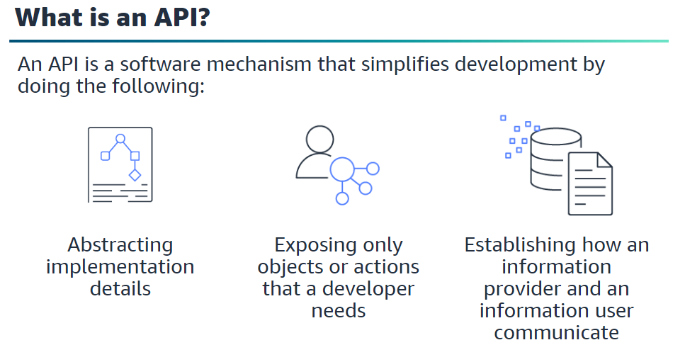

Slide 4
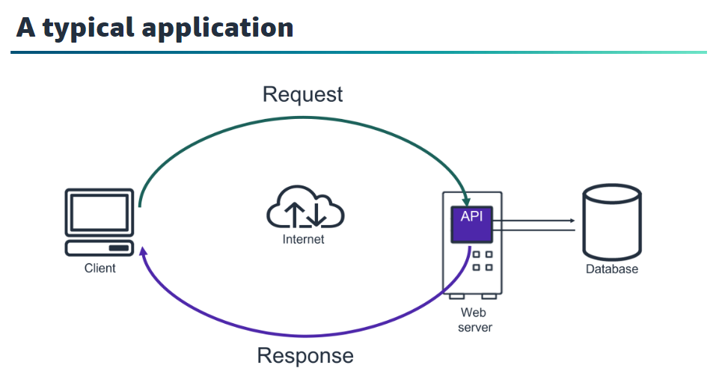

Slide 5
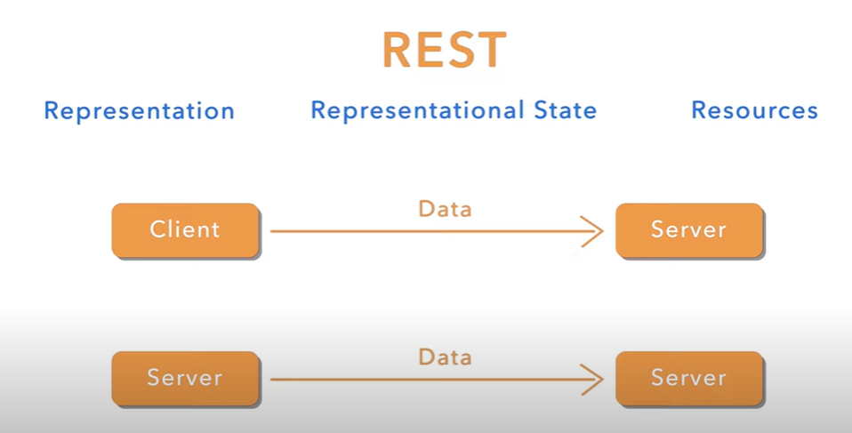

Slide 6
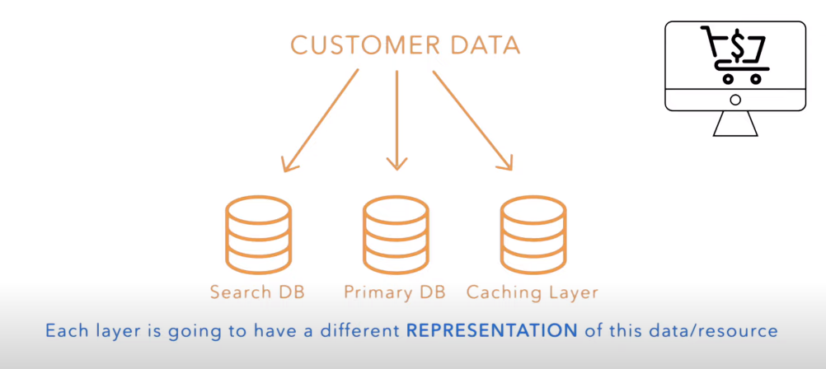

Slide 7
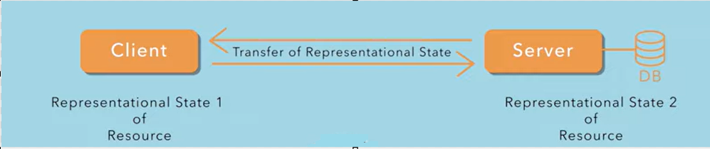

Slide 8
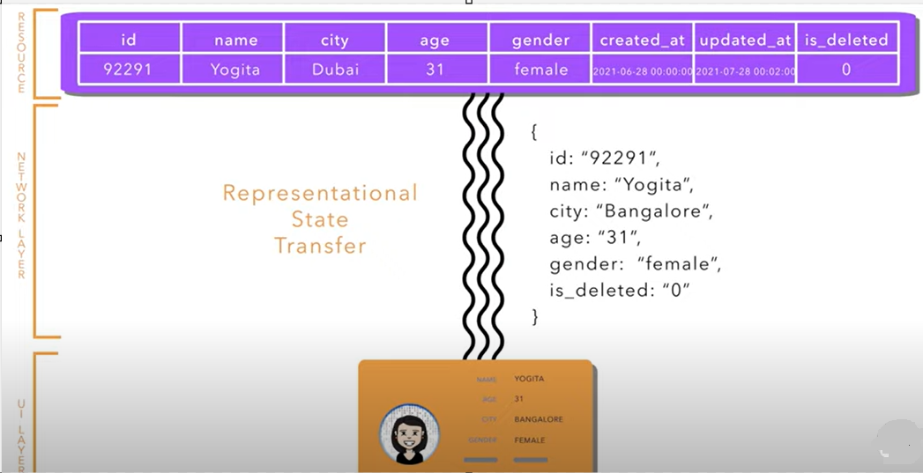

Slide 9
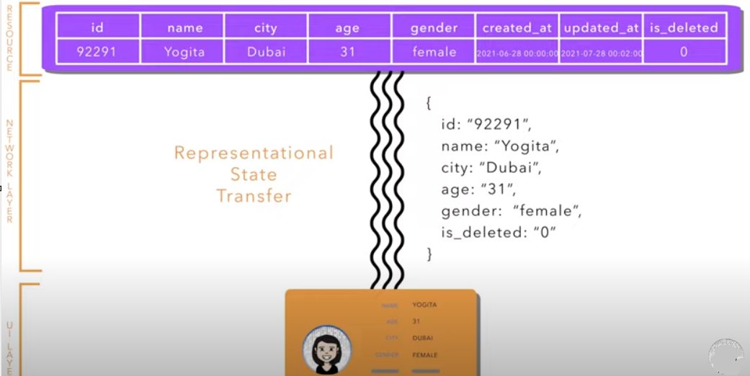

Slide 10
REST APIs is about
Pass Representational state from one layer to another layer
Representation of these resources
Managing the resources

Slide 11
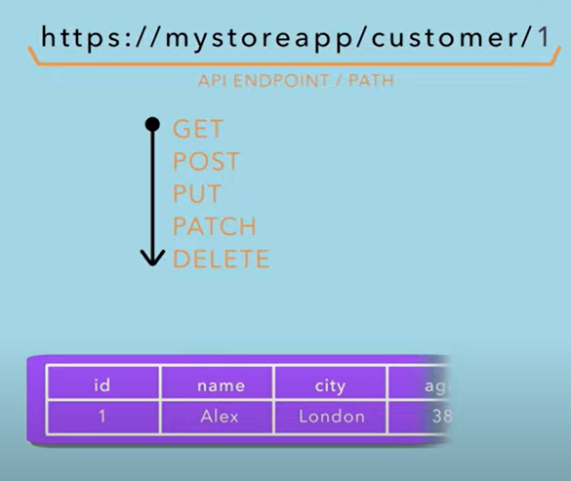

Slide 12
Example:
Suppose we have a Student Management System.
GET /students → Fetch all students
POST /students (with student data) → Add a new student
PUT /students/1 (with updated data) → Update student with ID 1
DELETE /students/1 → Delete student with ID 1

Slide 13
Path Parameter Query Parameter

Slide 14
Path Parameter:
Path Parameter:
Part of the URL path itself.
Used to identify a specific resource.
Required for the endpoint to work.

Slide 15
GET /users/{id}
/users/92291
Result: It fetches the user with ID 92291.
Response:
{
"id": "92291",
"name": "Yogita",
"city": "Dubai",
"age": "31",
"gender": "female"
}

Slide 16
Query Parameter:
Appended to the URL after a ?.
Used to filter, sort, or search.
Optional and can have multiple values.

Slide 17
Example: GET /users?city=Dubai&age=31
URL: /users?city=Dubai&age=31
Result: It fetches all users in Dubai, aged 31.
Response:
[
{
"id": "92291",
"name": "Yogita",
"city": "Dubai",
"age": "31",
"gender": "female"
}
]

Slide 18
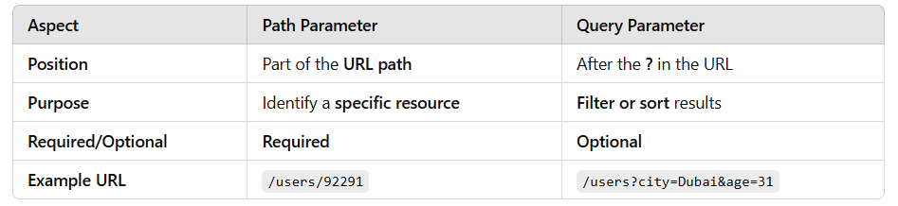
Key Differences:

Slide 19
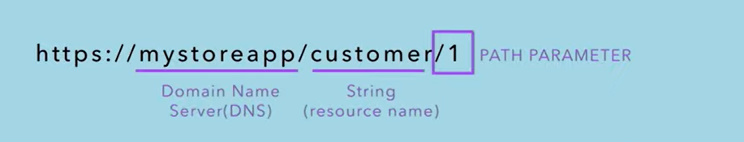
Path Parameter

Slide 20
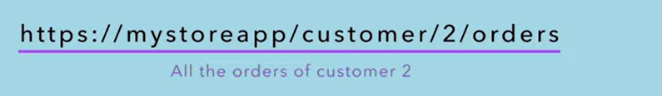
Customers has orders

Slide 21
There can be URIs without path parameters
Ex: https://mystoreapp/customers
Path Parameter:
Variable in URI path that helps in pointing towards specific location.

Slide 22
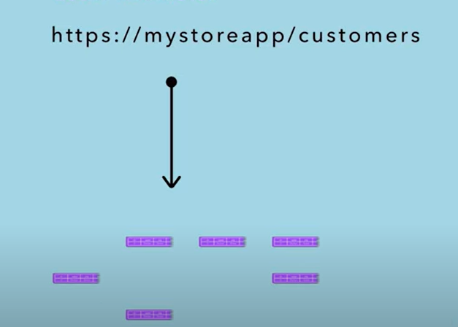
Query Parameter

Slide 23
Ex: If we want search only customers whose name have “abc” in it
https://mystoreapp/customers?name=abc
Query parameter:
Variable in a URI that queries/filters through a list of resources.

Slide 24
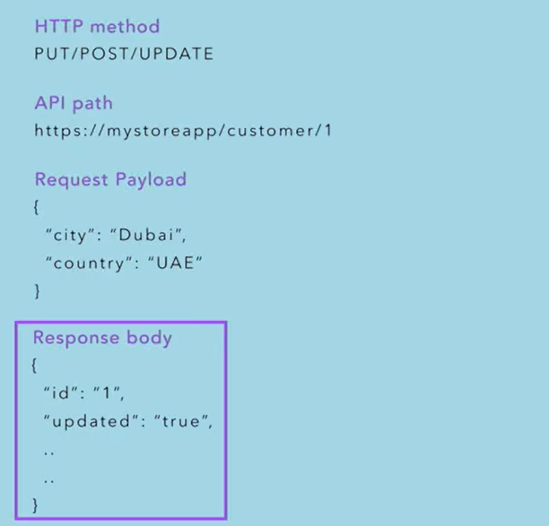

Slide 25
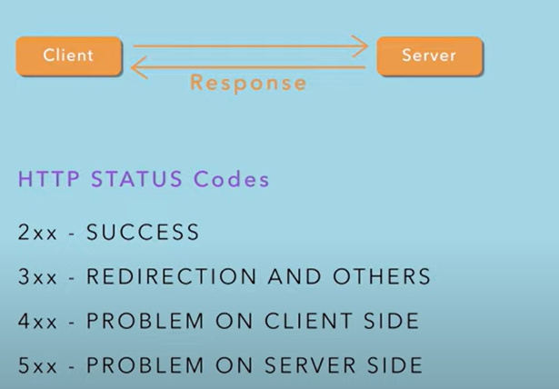
Response Codes

Slide 26
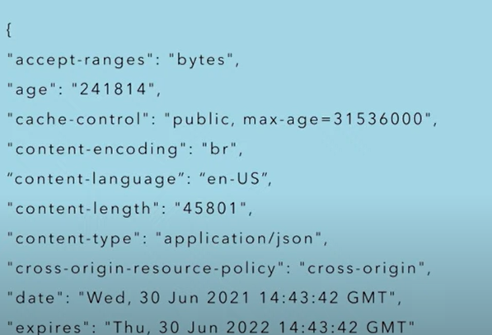
HTTP Headers
Set of attributes that corresponds to any meta-data associated with the API request.

Slide 27
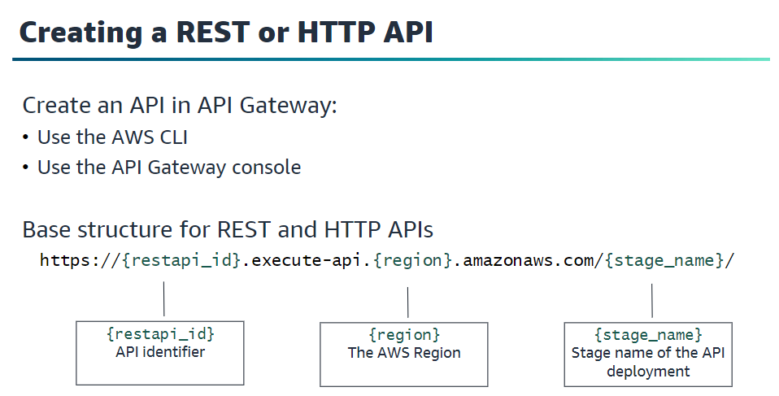

Slide 28
URL Components:
{restapi_id} → API Identifier (unique to your API)
{region} → AWS Region where your API is deployed (e.g., us-east-1)
{stage_name} → The stage of the API (like dev, test, prod)

Slide 29
Example URL:
https://abc123.execute-api.us-west-2.amazonaws.com/prod/
In this example:
API ID: abc123
Region: us-west-2
Stage: prod (production environment)

Slide 30
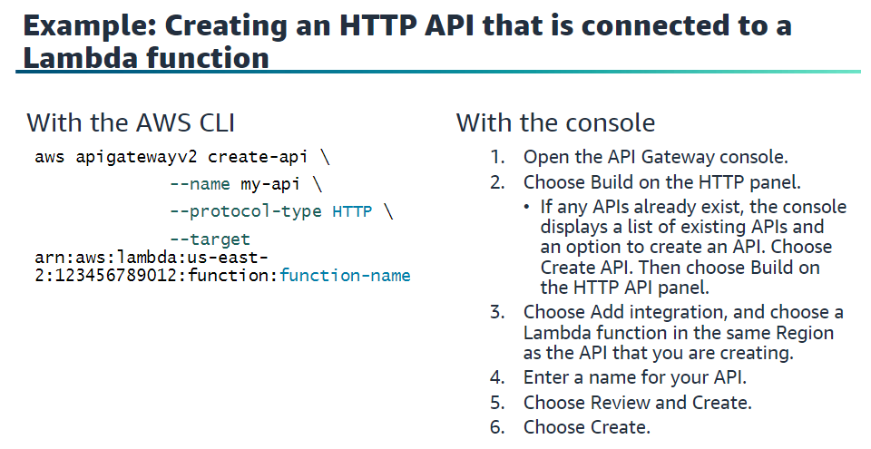

Slide 31
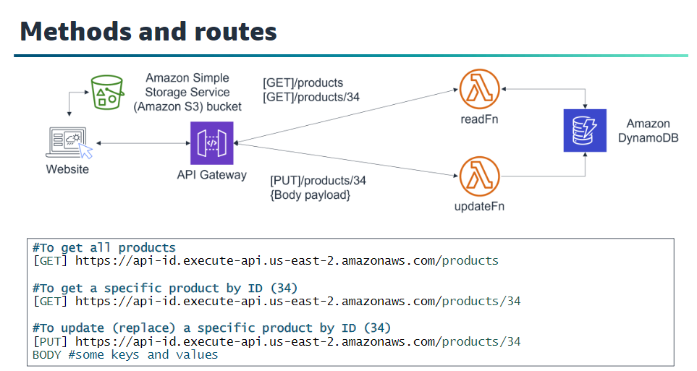

Slide 32
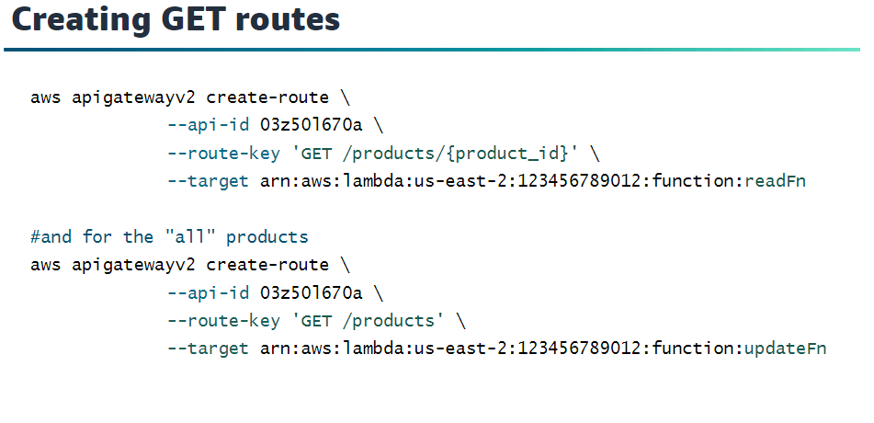

Slide 33
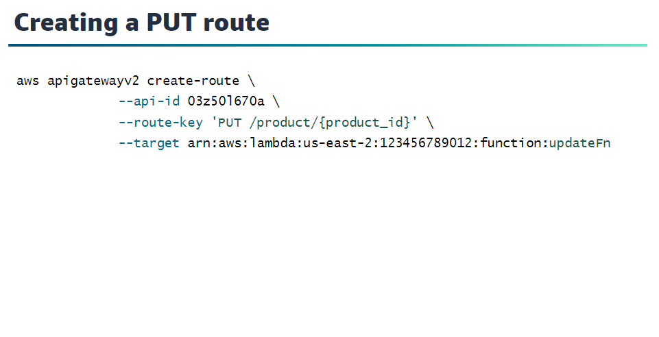

Slide 34
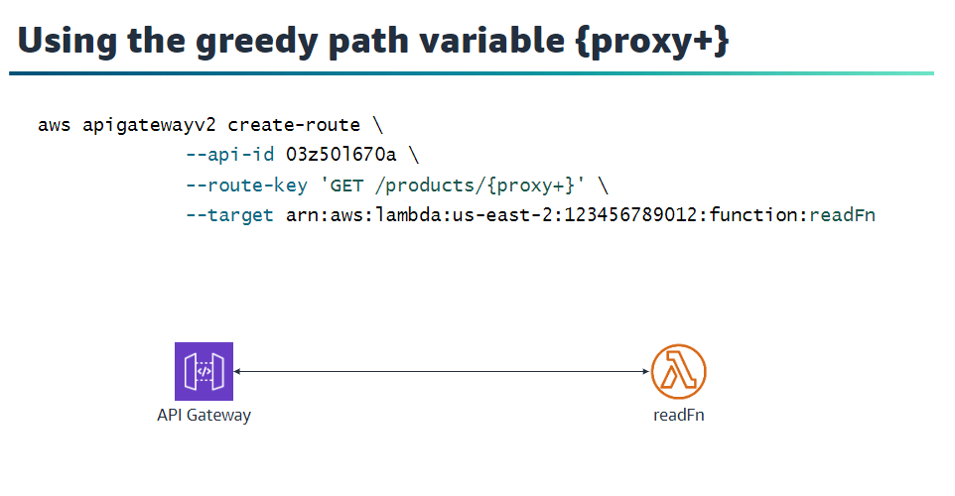

Slide 35
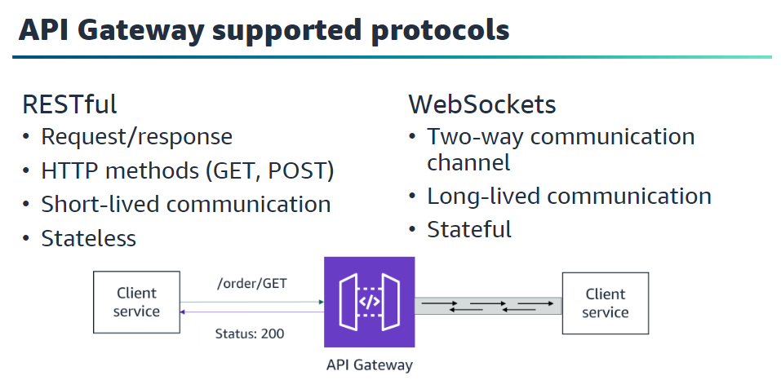

Slide 36
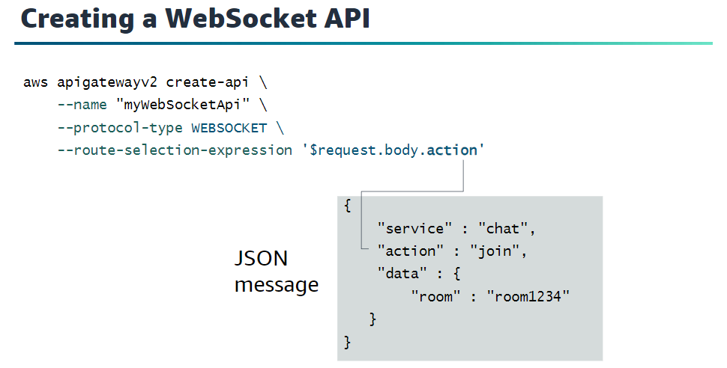

Slide 37
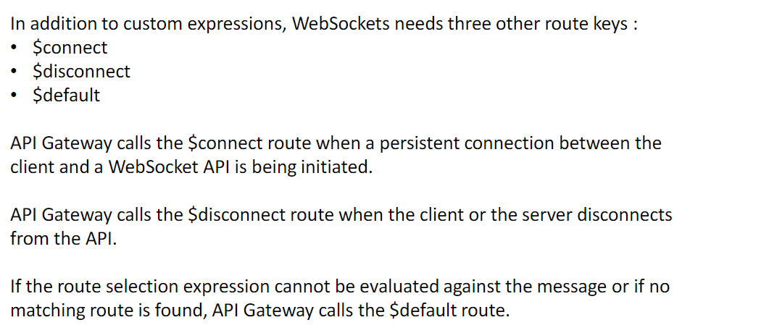

Slide 38
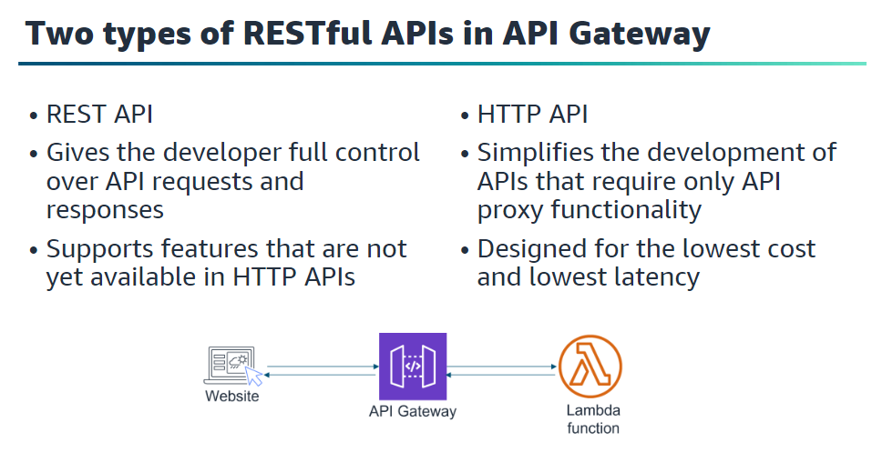

Slide 39
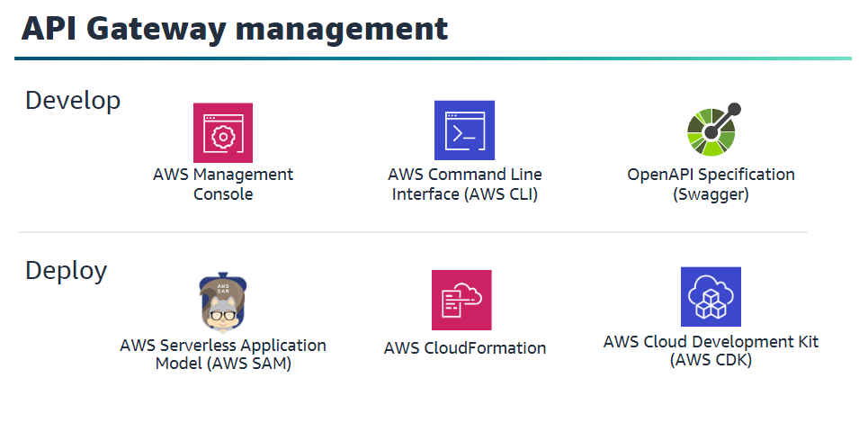

Slide 40
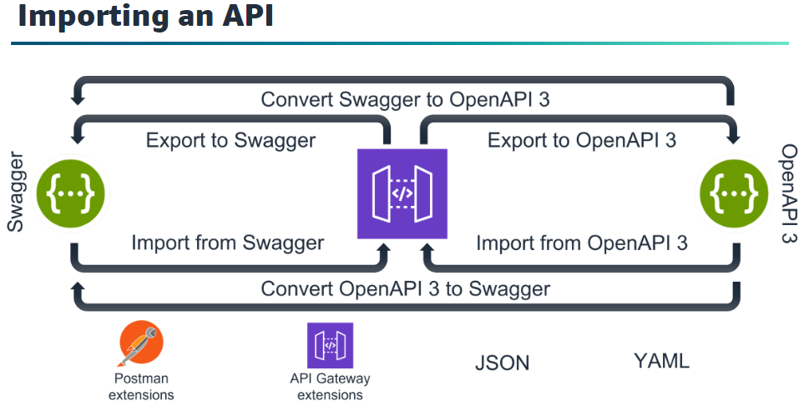

Slide 41
